Slide 1
Collide
Low-Fi Prototyping &
Pilot Usability Testing

Slide 2
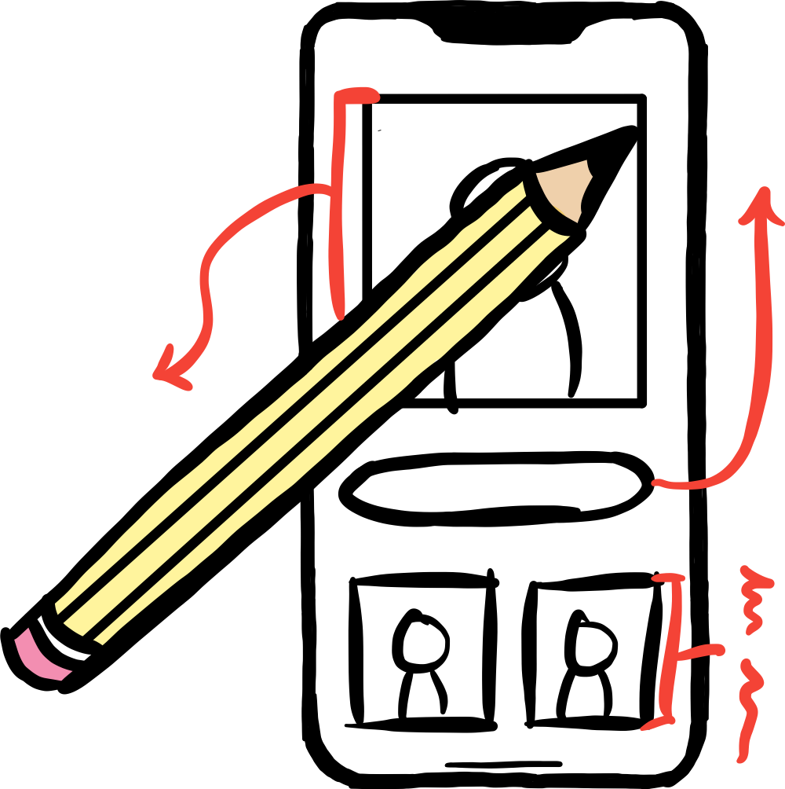
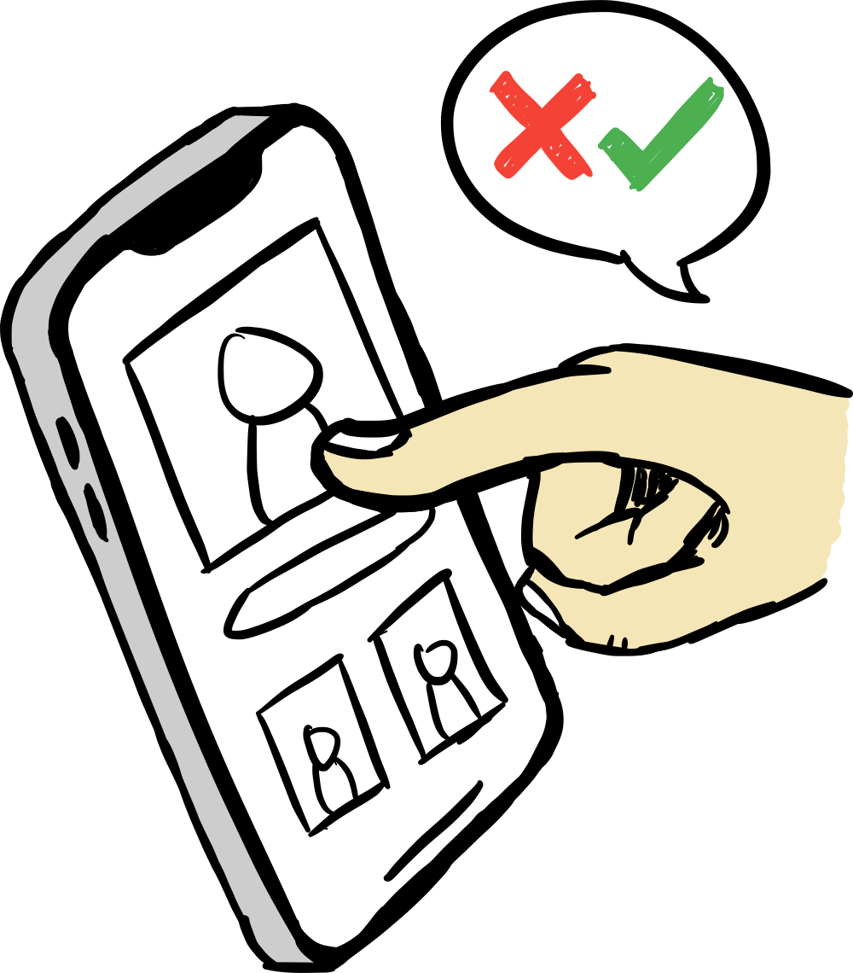
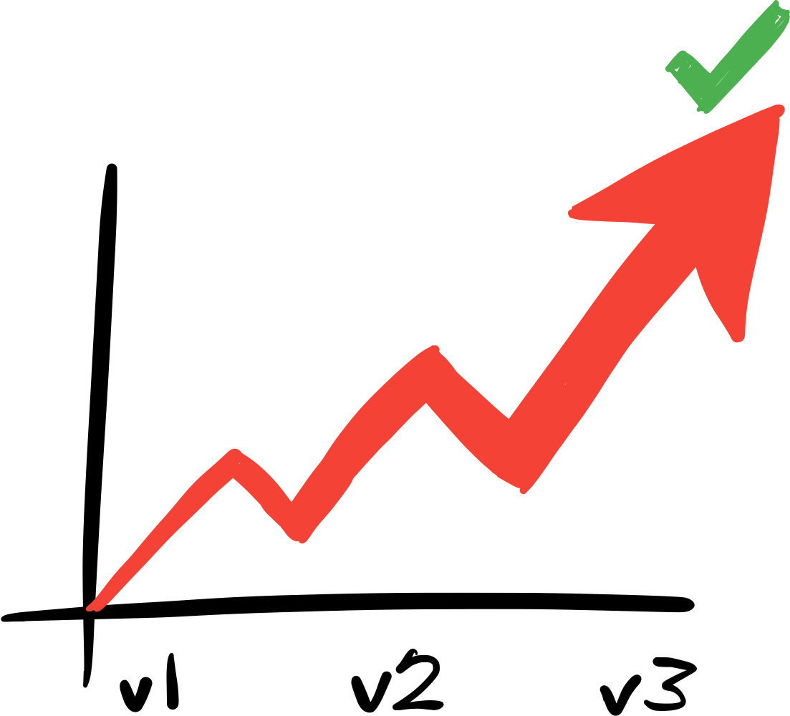
Overview
Prototyping
Testing
Improving

Slide 3
Prototyping

Slide 4
Our Mission
The problem:
Transitioning to a new environment, people find it difficult to make meaningful connections and are fearful of reaching out.
Our solution:
We want to solve this by creating opportunities for people, who would have otherwise passed by each other, to stop and talk.
Your next best friend is just around the corner.

Slide 5
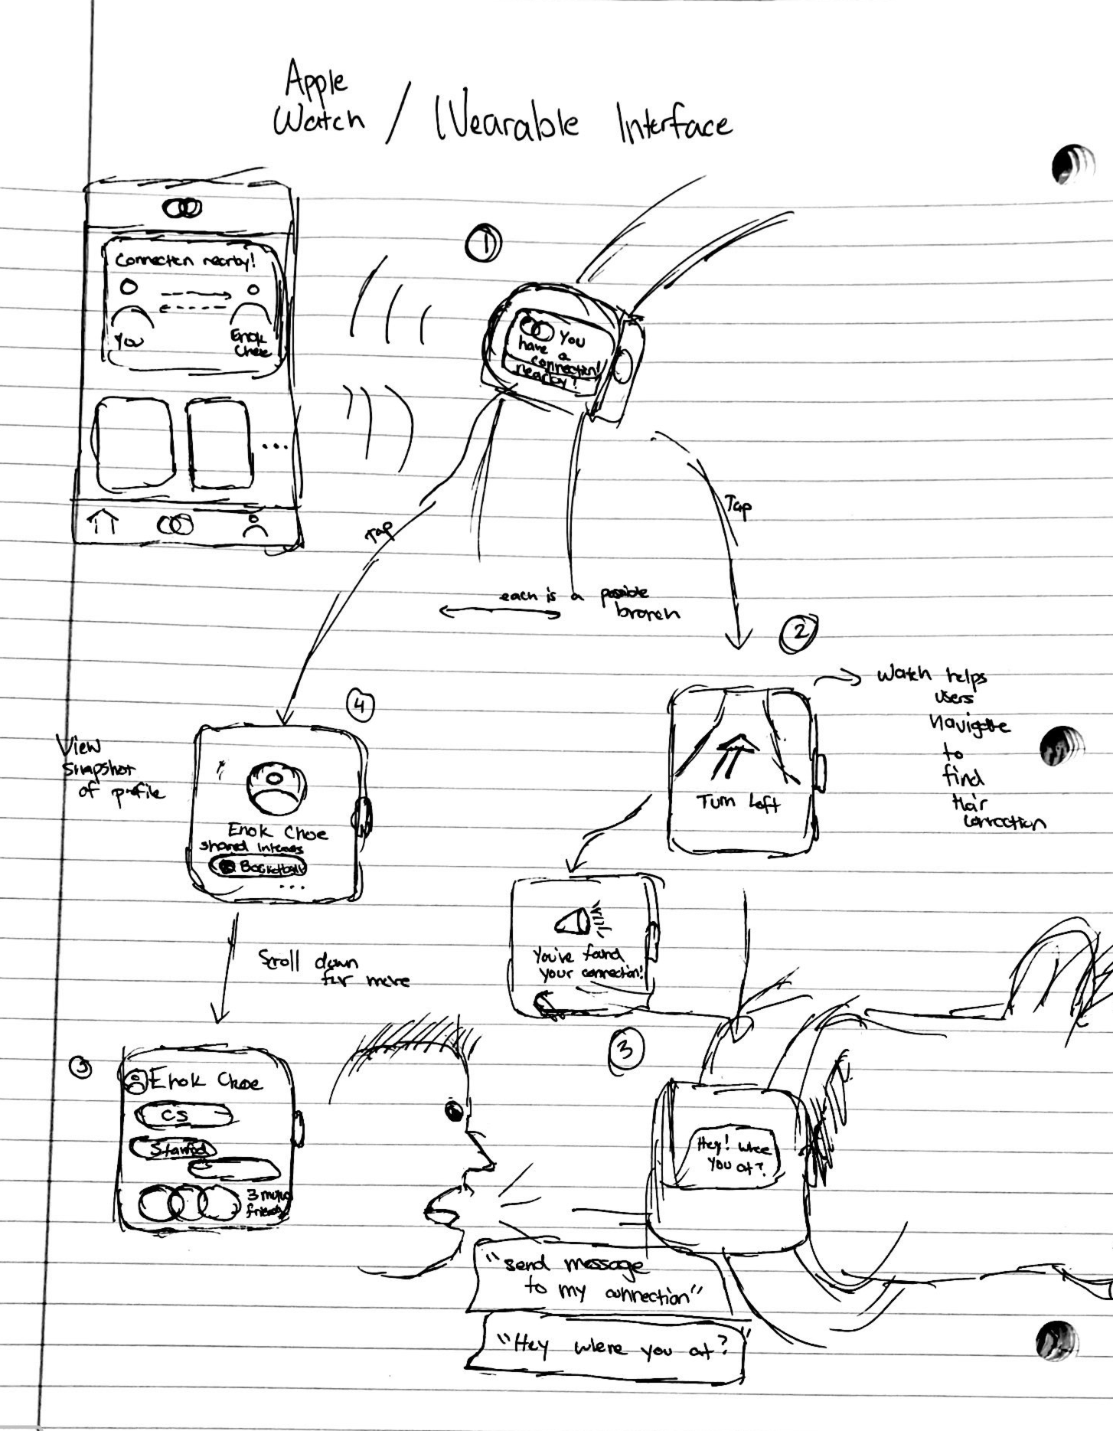
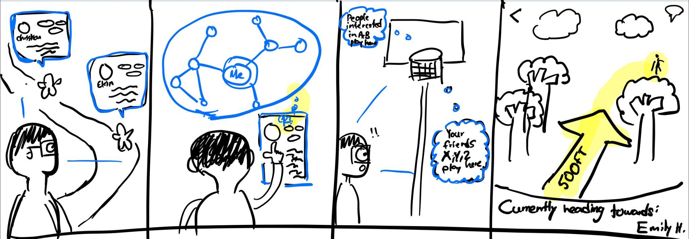
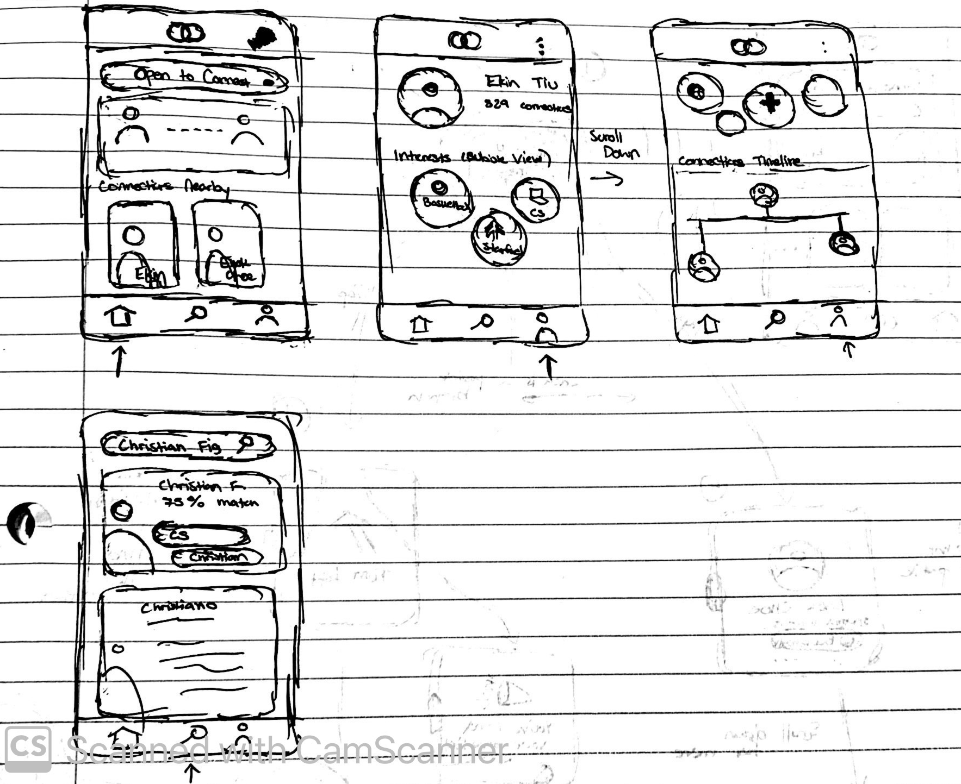
Choosing a Modality
Wearable
Wearable
AR
AR
Mobile Phone #1
Audio
Mobile Phone #2
Mobile Phone #2

Slide 6
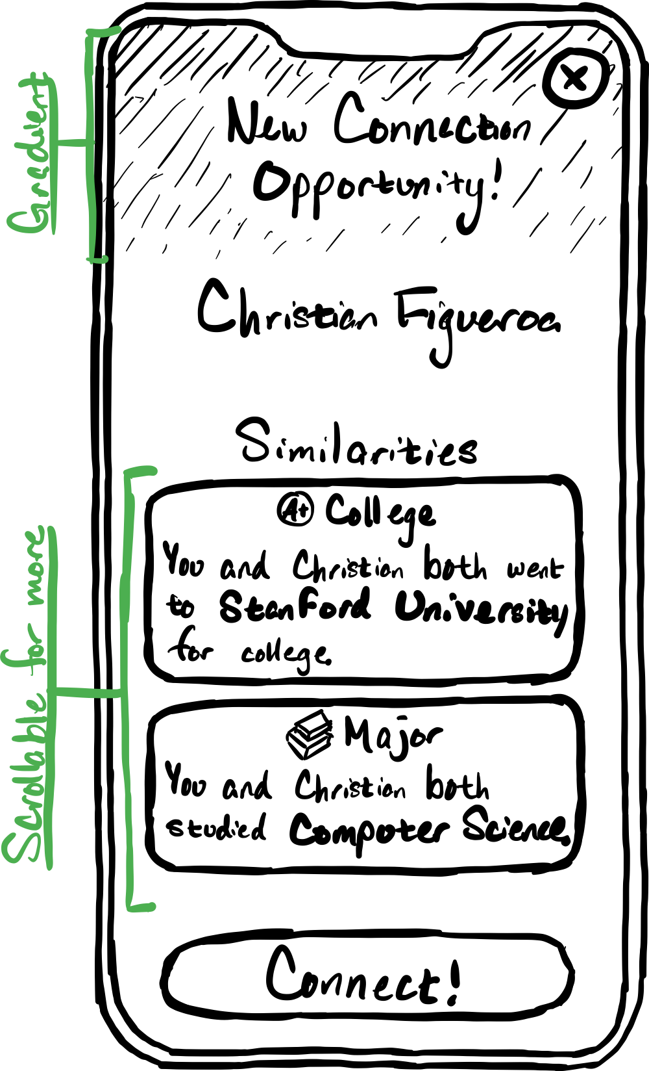
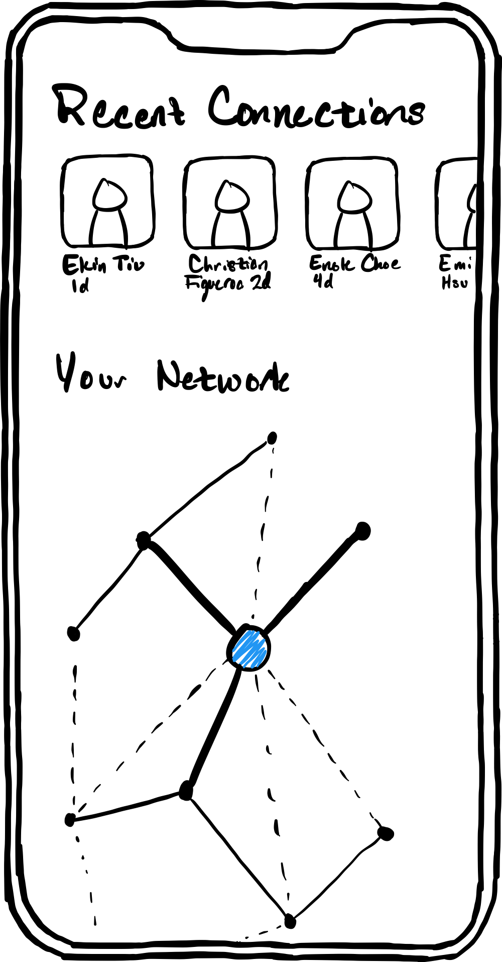
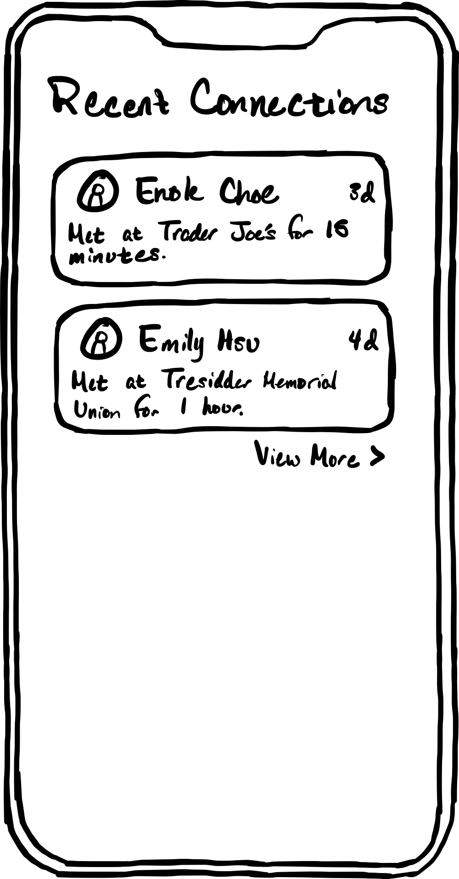
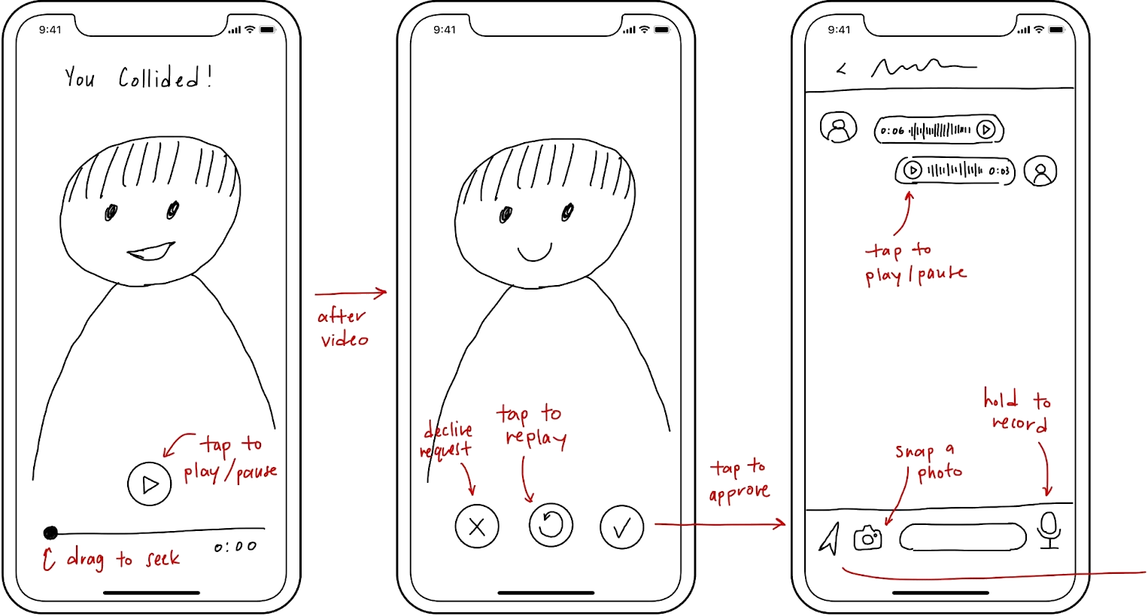
Choosing a Modality
Mobile Phone
Audio
Audio

Slide 7
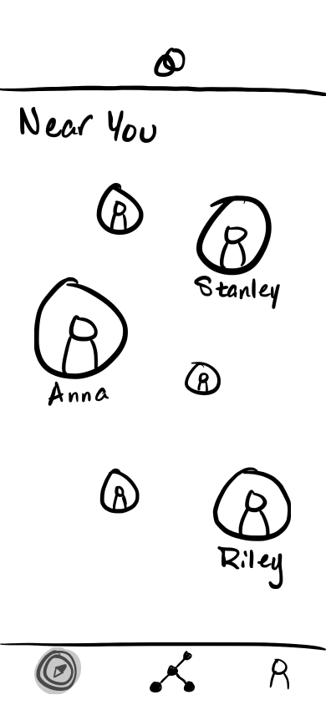
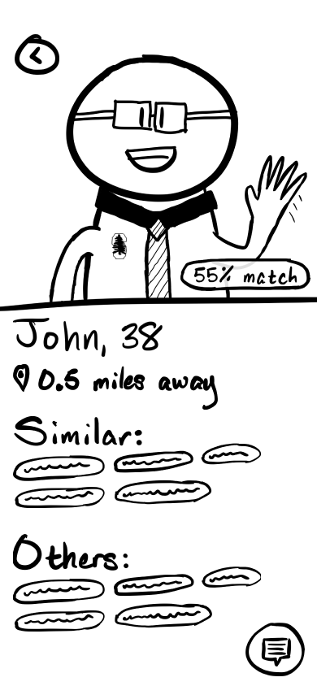
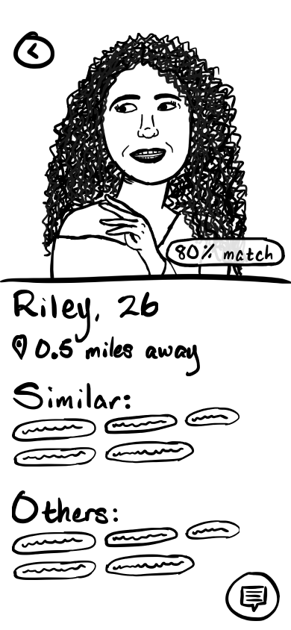
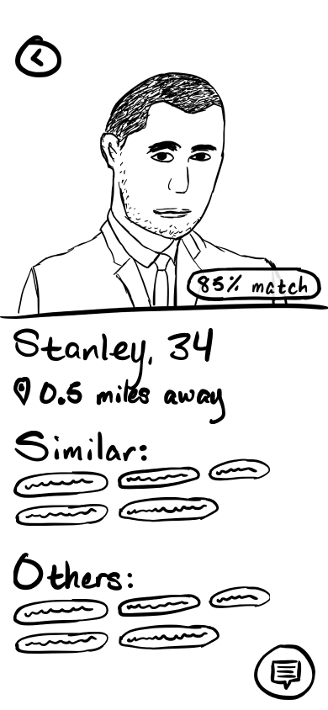
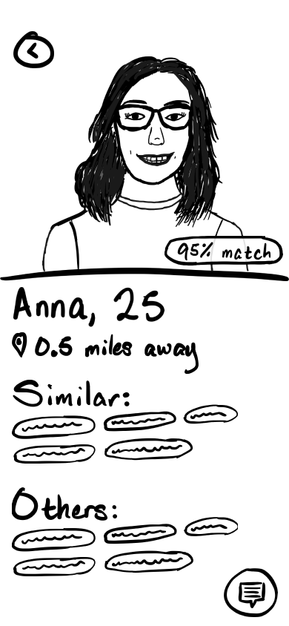
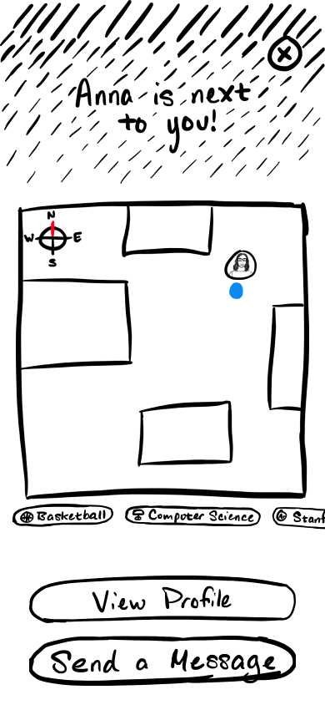
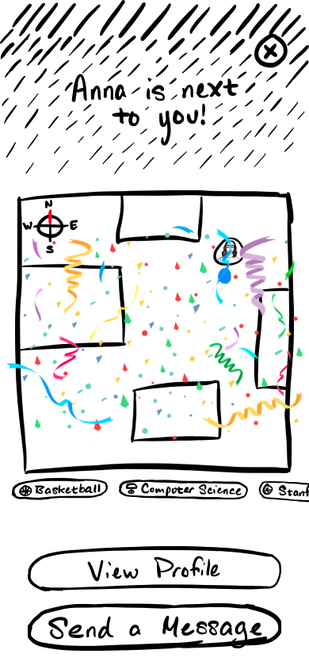
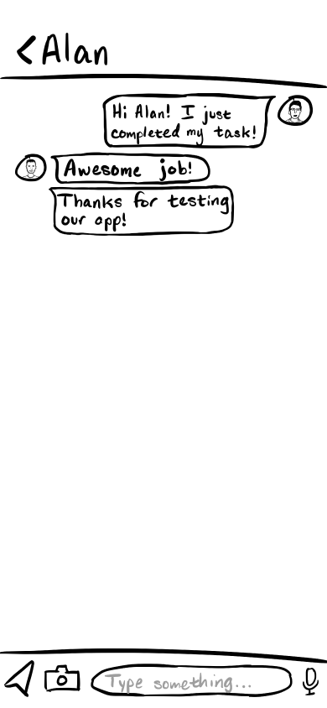
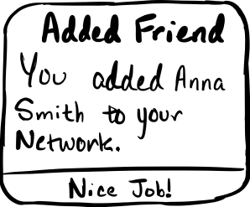
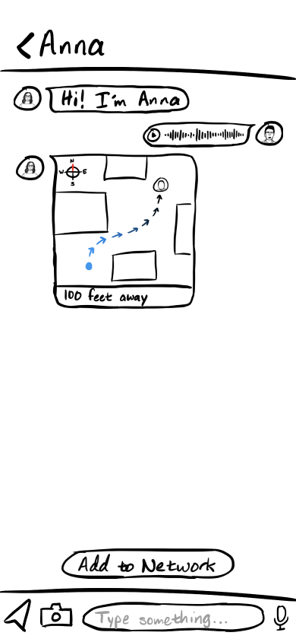
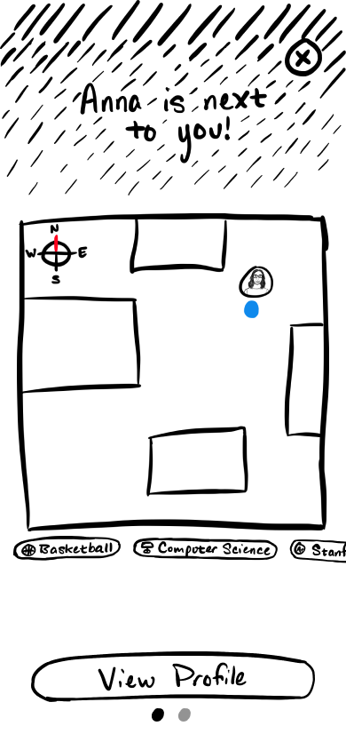
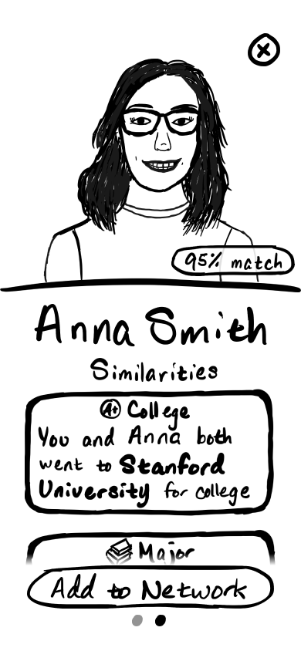
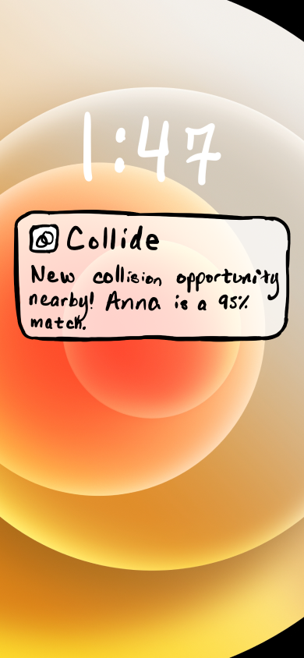
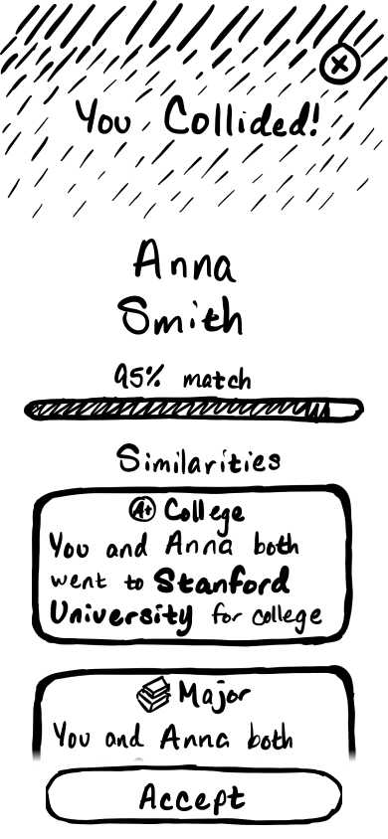
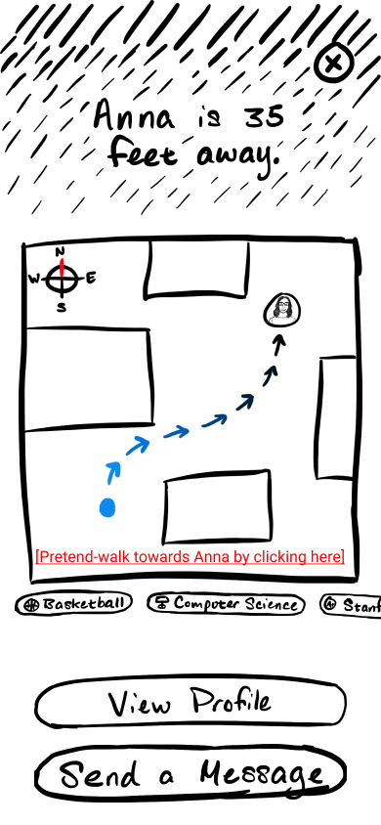
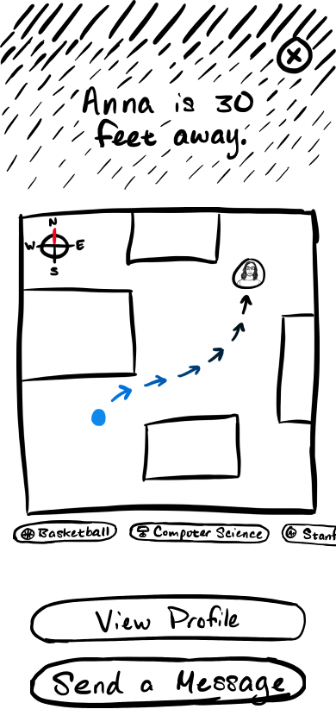
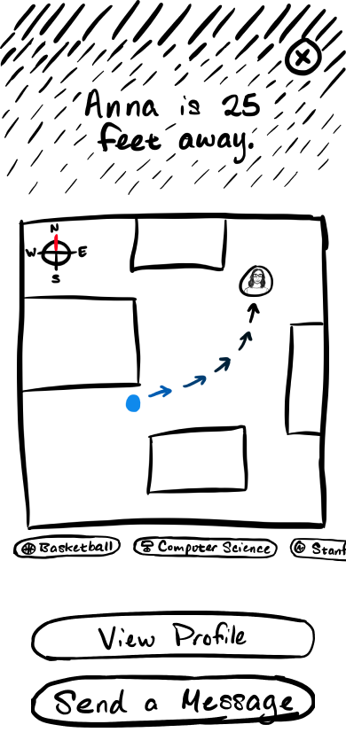
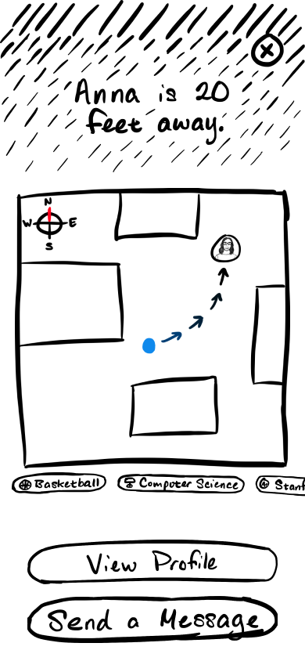
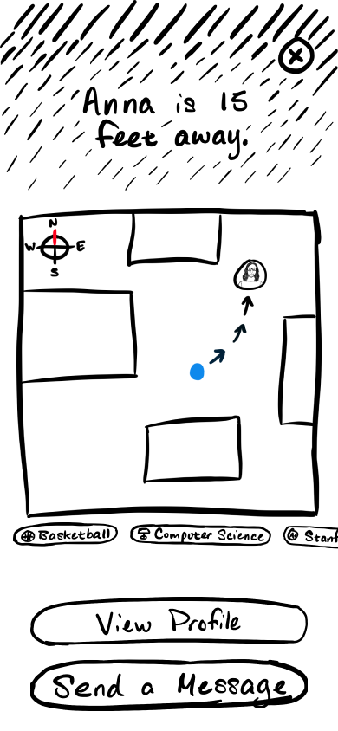
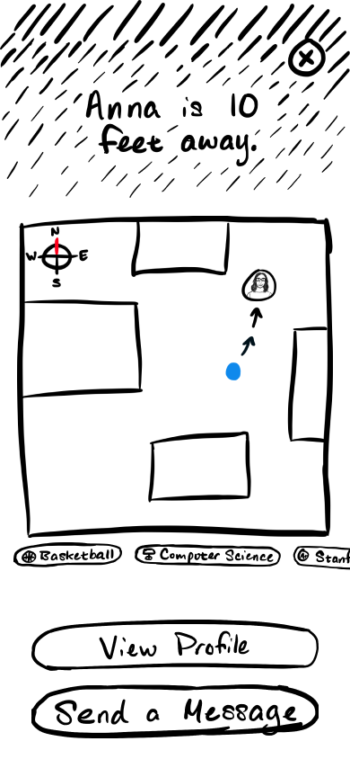
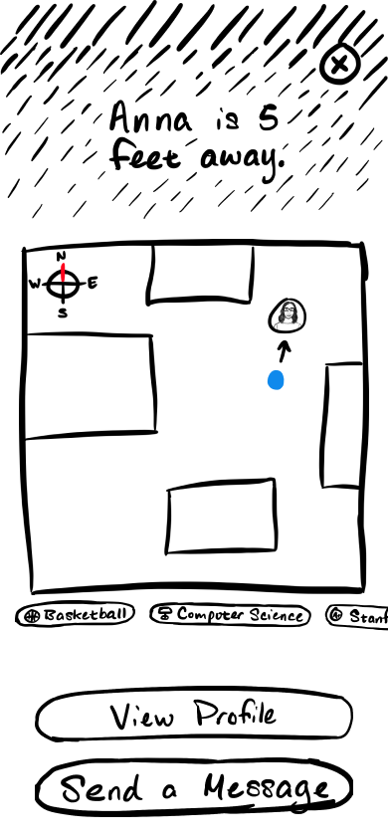
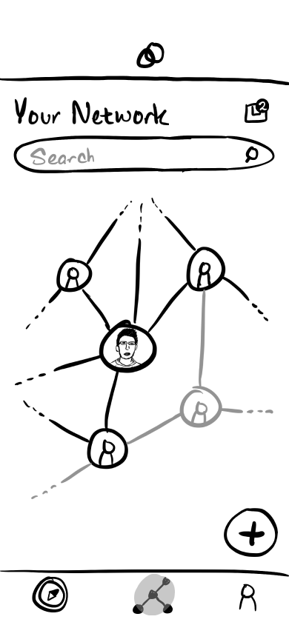
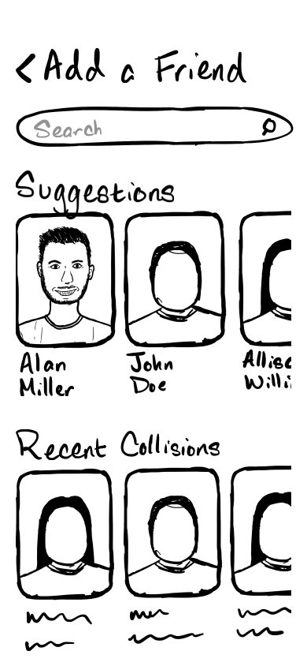
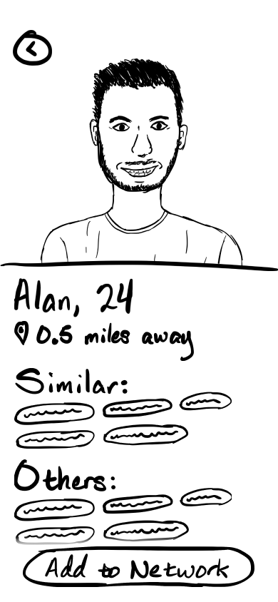
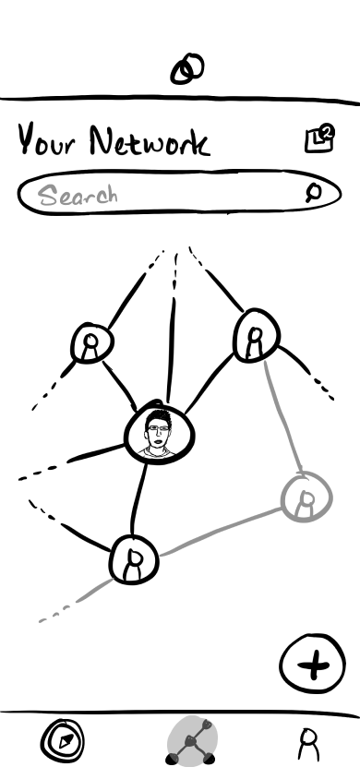
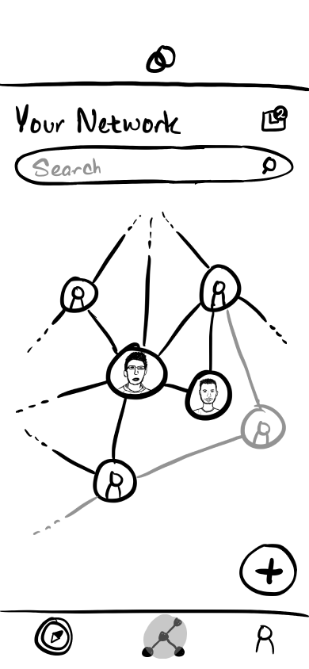
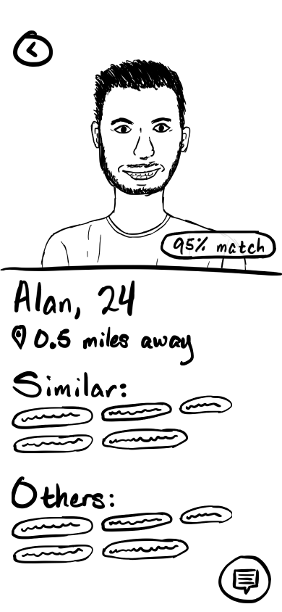
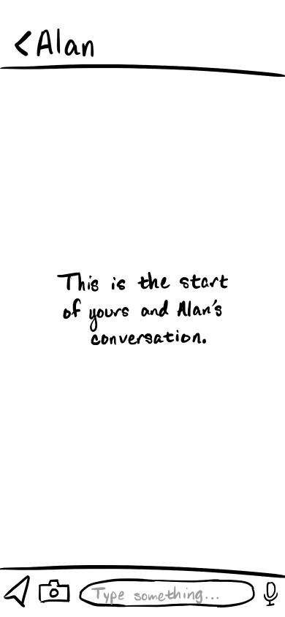
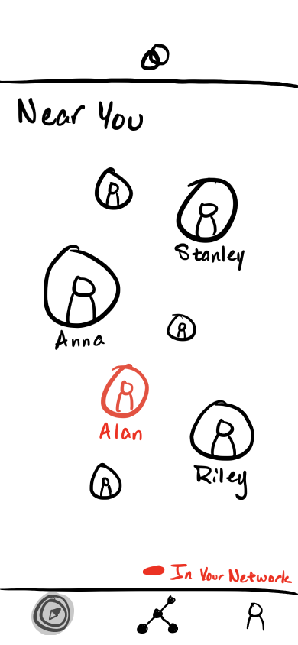
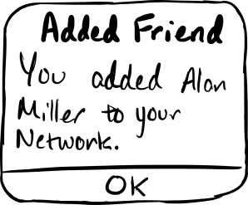
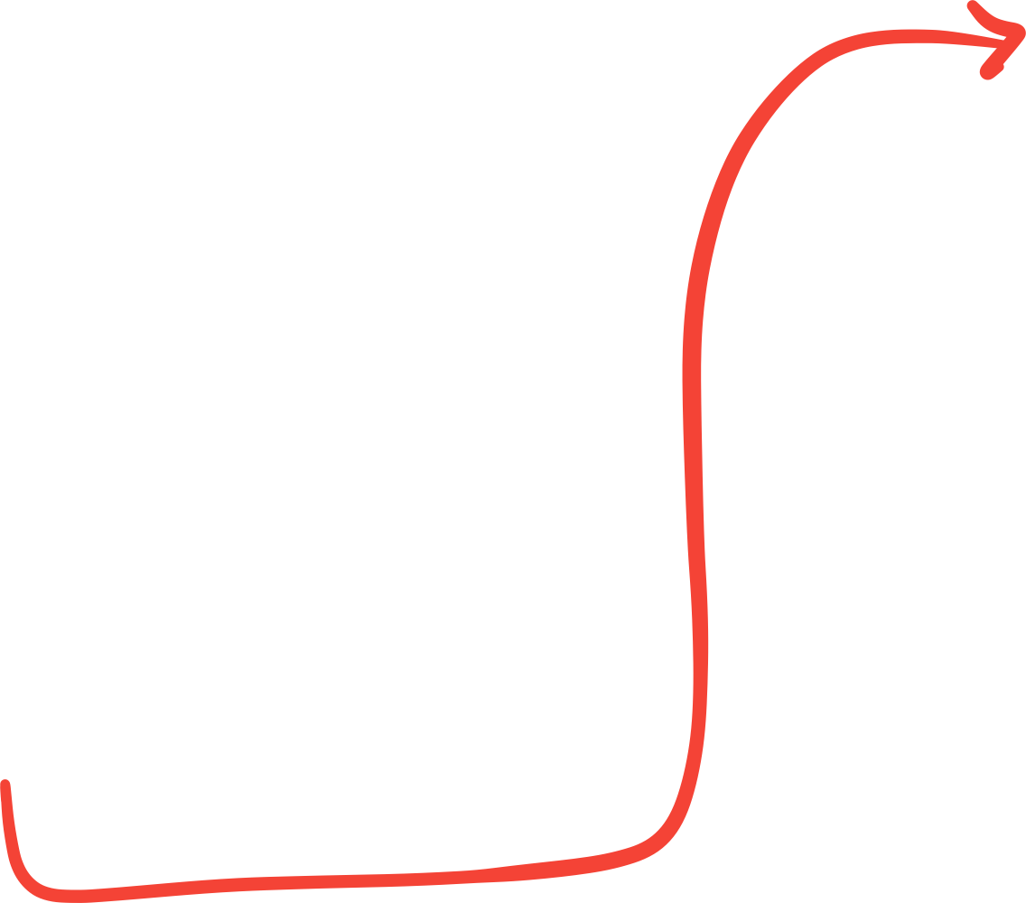
Final Prototype

Slide 8
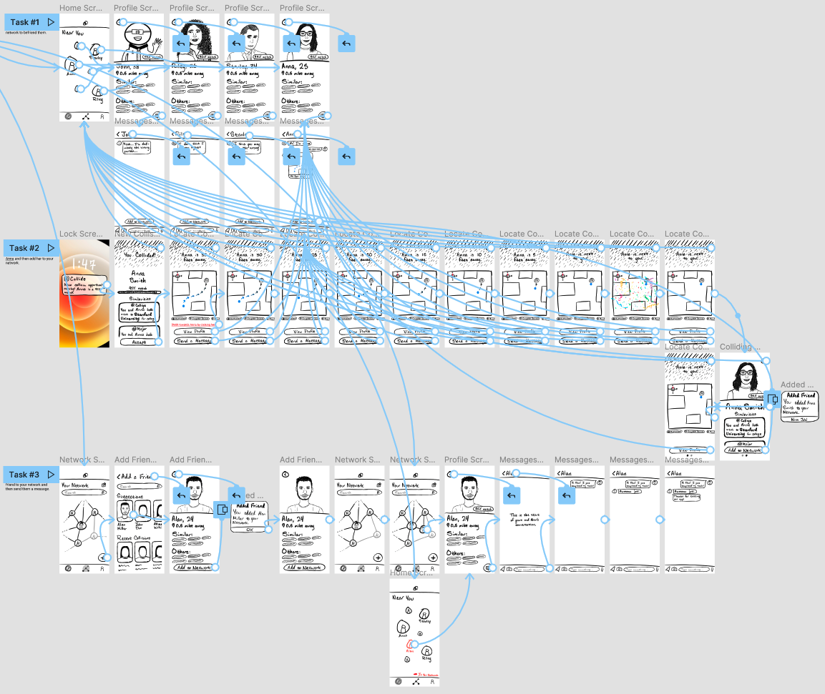
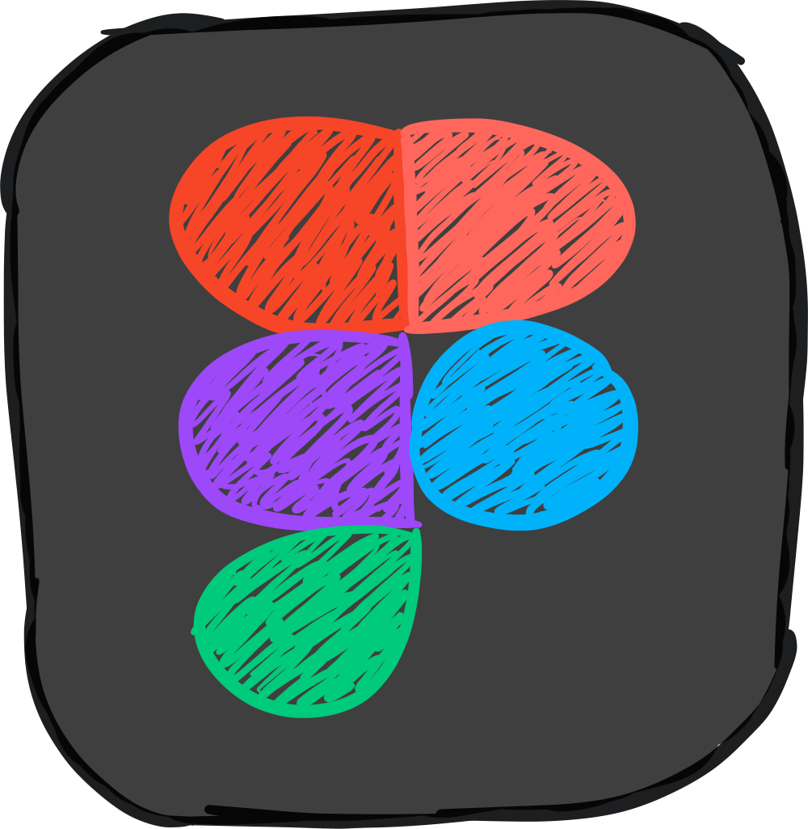
Final Prototype

Slide 9
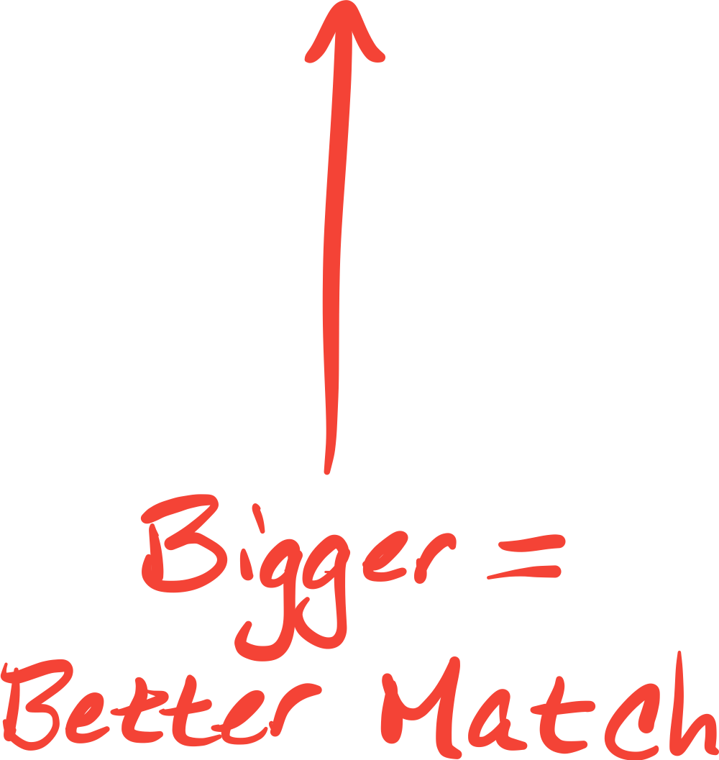
Task #1: Simple
Befriend someone near you with similar interests.

Slide 10
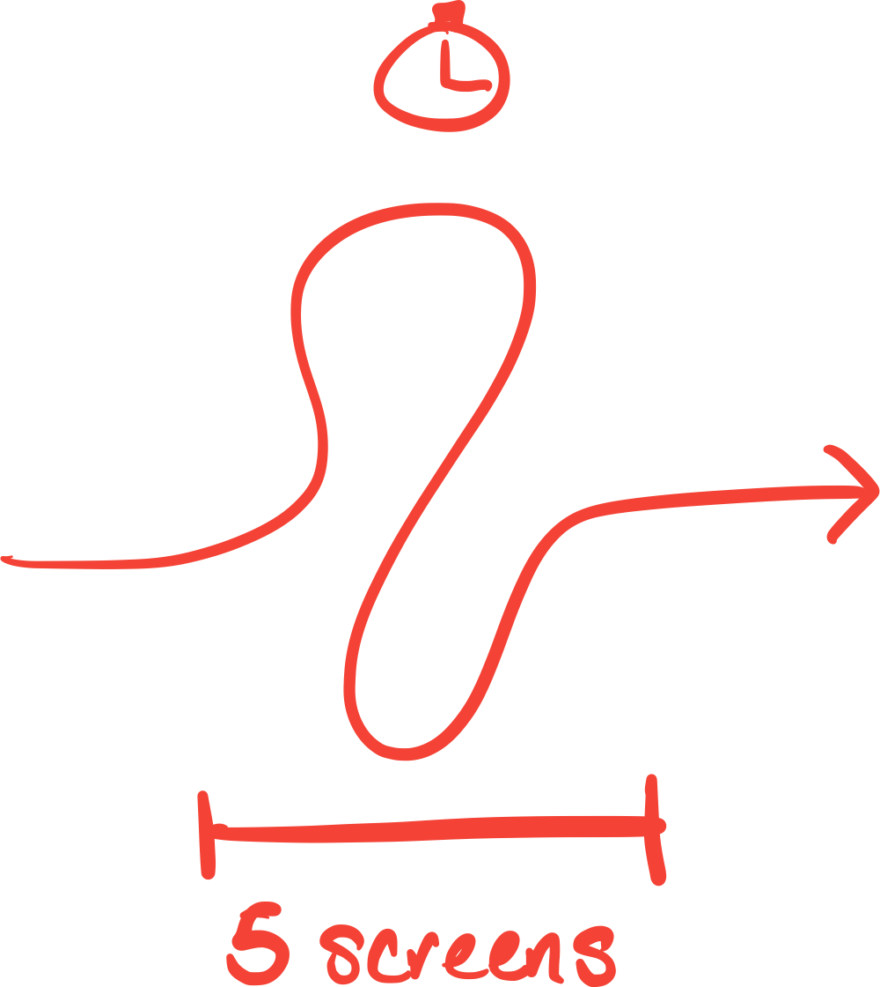
Task #2: Moderate
Start a conversation with someone in person.

Slide 11
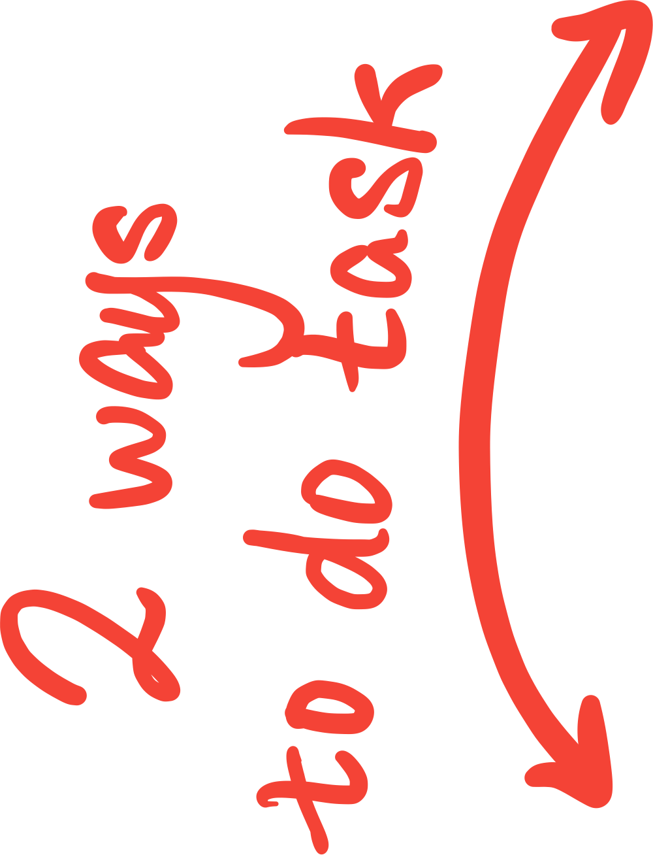
Task #3: Complex
Reconnect with a past friend.

Slide 12
Testing

Slide 13
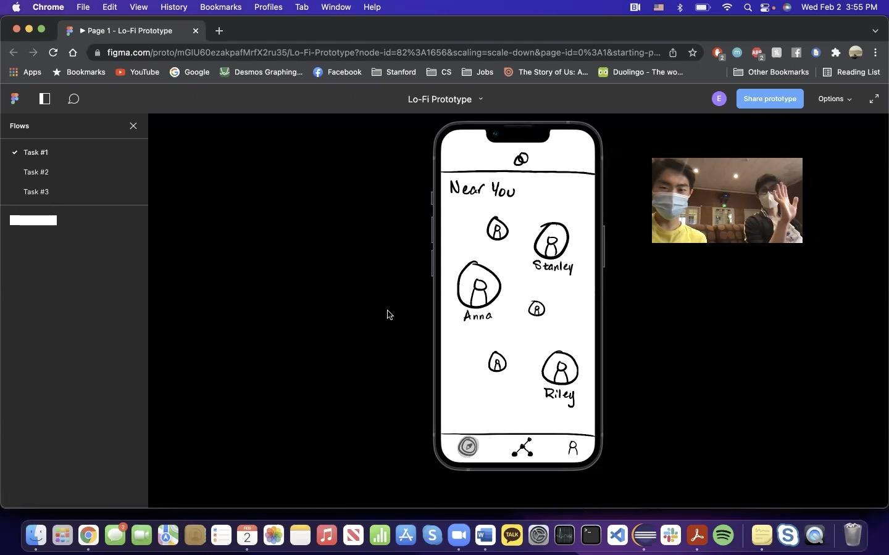
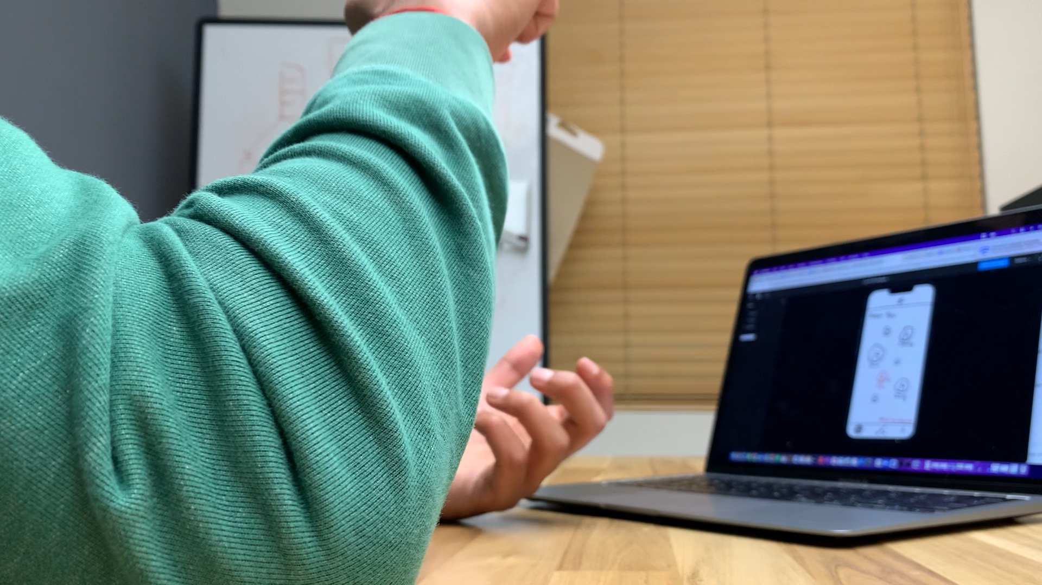
Experimental Method
Conducted in person or over Zoom
Both engineering and non-engineering backgrounds
Used Figma for handling user interaction
One facilitator and one note taker, shared notes as group

Slide 14
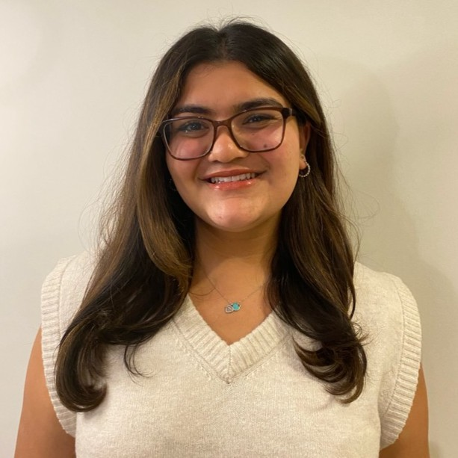
Our Interviewees
Esha
UC San Diego
Economics Student
Jasper
Stanford
CS Student
Yasmine
Sheridan College
Design
Vrishab
Valar Labs
Engineer

Slide 15
Improving

Slide 16
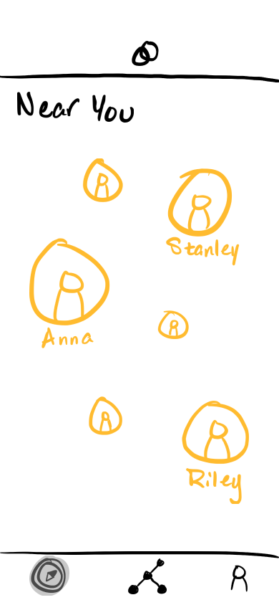
Feedback

Slide 17
Feedback
Comments:
Everyone liked the networking graphic.
Improvements:
Flesh out the networking map even more to make it interactive (e.g., scroll, zoom, etc.).

Slide 18
Feedback
Comments:
Most found the bubble sizes intuitive, but wanted it to be more map-like.
Improvements:
Keep the bubble sizes, make it clear how far people are from you.

Slide 19
Feedback
Comments:
Most thought the “Accept” button was confusing and
didn’t realize it would share location.
Improvements:
Change the wording and add more options (e.g., “Share Location”, “Chat”)

Slide 20
Feedback
Comments:
Most wanted the “Add to Network” button on the
Profile page instead of Messages.
Improvements:
Add that option to the Profile page as well so it’s easier to find.

Slide 21
Feedback

Slide 22
Summary of Improvements
Make the Networking map more interactive

Slide 23
Summary of Improvements
Make the Networking map feel more interactive
Improve the structure of the Near You page

Slide 24
Summary of Improvements
Make the Networking map feel more interactive
Improve the structure of the Near You map
Make location sharing feel more secure

Slide 25
Summary of Improvements
Make the Networking map feel more interactive
Improve the structure of the Near You map
Make location sharing feel more secure
Make it easier to navigate the app

Slide 27
Summary of Improvements
Make the Networking map feel more interactive
Improve the structure of the Near You map
Make location sharing feel more secure
Make it easier to navigate the app

Slide 29
Things We Did Right
Liked that there were two ways to do Task #3

Slide 30
Things We Can Improve
Require permission for adding to network
See Match score before adding to network (#3)
See Match Score on Near You page
More specific directions
See similarities before you get to Anna
Add names to Network (#3)

